Slide 1
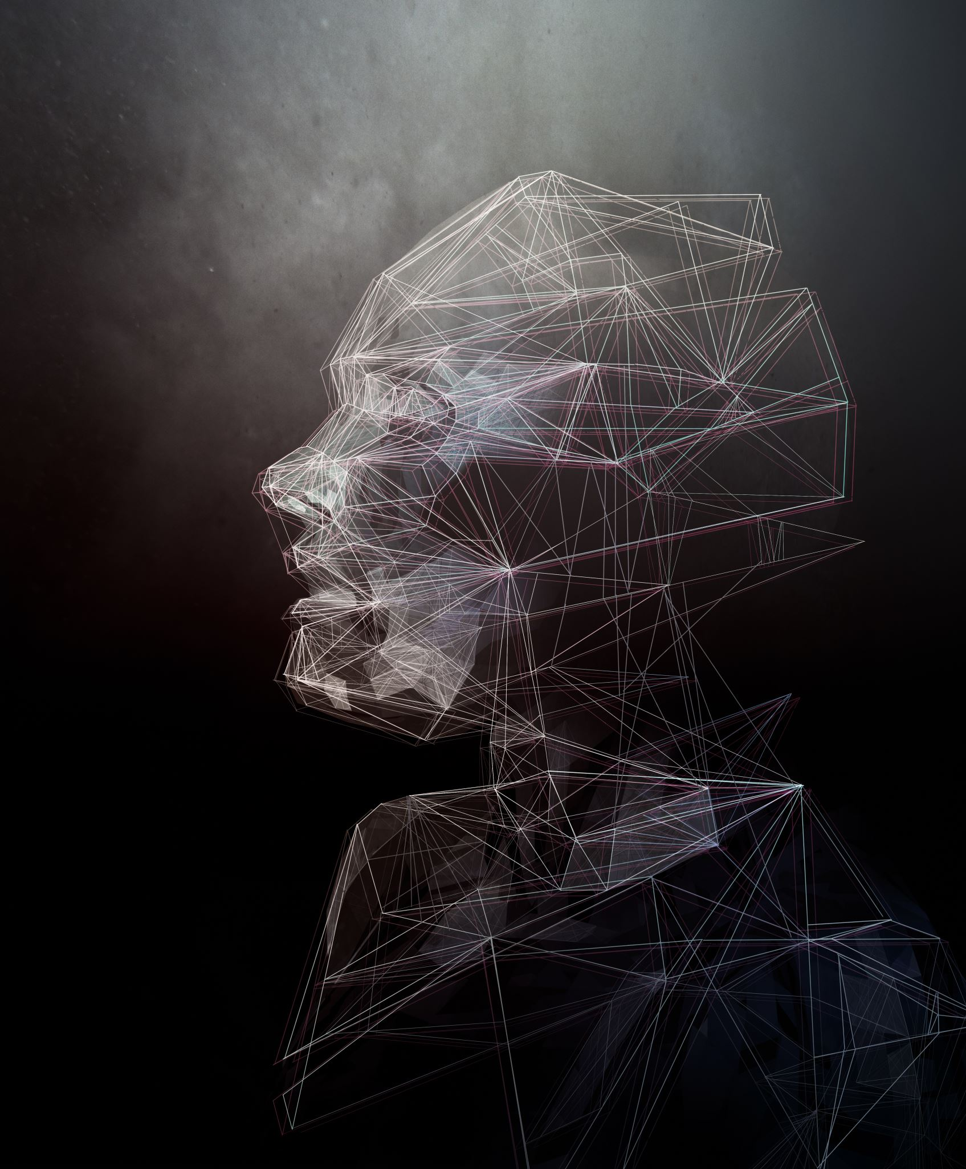
Real-Time Age, Gender, and Emotion Recognition Using Convolutional Neural Networks
Lian Duan
Dhruvil N. Shah
Nimit D. Hingrajia

Slide 2

Table of Contents
Problem Statement
Motivation
Datasets
Approach
Experiments
Results
Conclusion
Future Work
References

Slide 3
Problem Statement
There's a numerous number of CNN models have been implemented before to classify emotions. However, the methodology of detecting age and gender in real-time manner during classifying emotions has not been provided.
Also, which models are the best for classifying which attributes still need to be decided

Slide 4
Motivation
Face recognition is one of the most sought-after topics in the computer vision field (Adjabi et al., 2020)
Growing interest in video analysis using biometric data (Foggia et al., 2023)
Personalize advertising content
Business analytics
Surveillance systems
Cognitive robotics

Slide 5
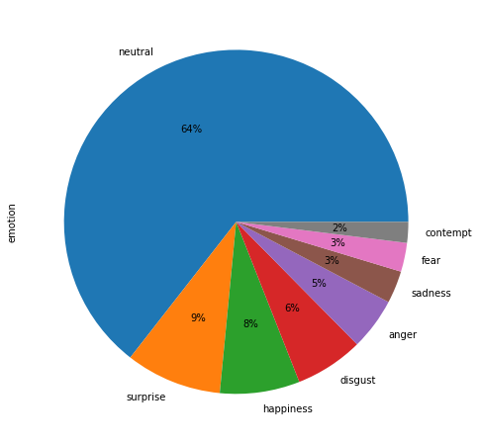
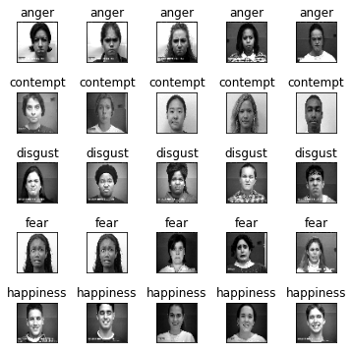
Datasets
Extended Cohn-Kanade (CK+)
920 images with 8 emotion classes: neutral, surprise, happiness, disgust, anger, sadness, fear, and contempt

Slide 6
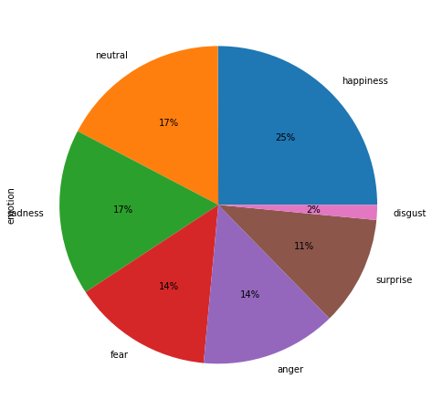
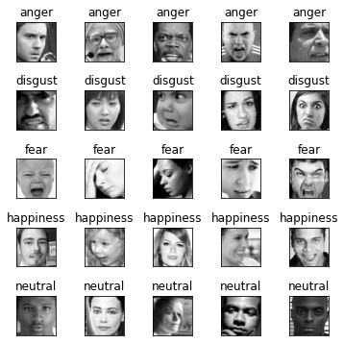
Datasets (Cont’d)
FER2013
35887 images with 7 emotion classes: anger, disgust, fear, happiness, sadness, surprise, and neutral
Benchmark for emotion recognition

Slide 7
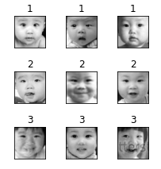
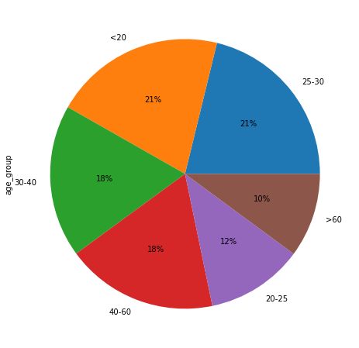
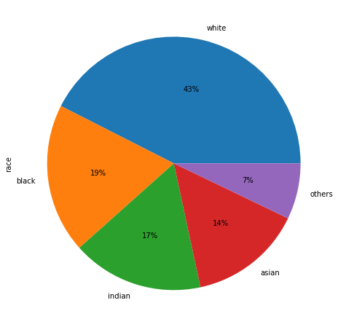
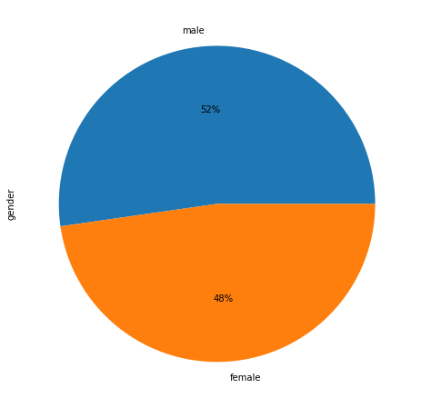
Datasets (Cont’d)
UTKFace
23705 images with annotations of age (0-116), gender (male, female), and race (White, Black, Asian, Indian, and others)

Slide 8
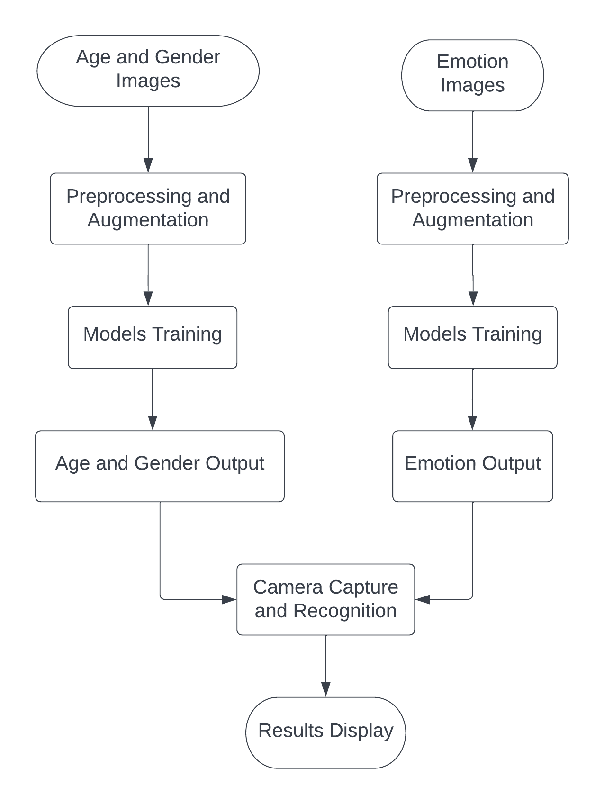
Approach

Slide 9
Experiments
Platforms
Jupyter Notebook with Python 3.9
GPU RTX 3060
Kaggle Notebook with Python 3.7.12
GPU Tesla P100
Toolkits and libraries
Tensorflow Keras
Scikit-learn
Nvidia CUDA
OpenCV

Slide 10
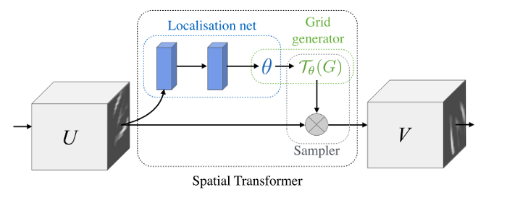
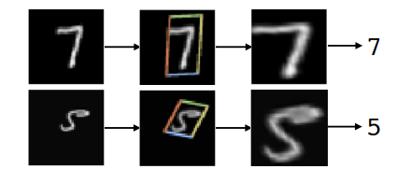
Experiments (Cont’d)
Spatial Transformer
Developed by Google DeepMind
Enhance the geometric invariance of the model
Can be incorporated into CNN as the first layer
Input: Full images
Output: Region of interest from input images

Slide 11
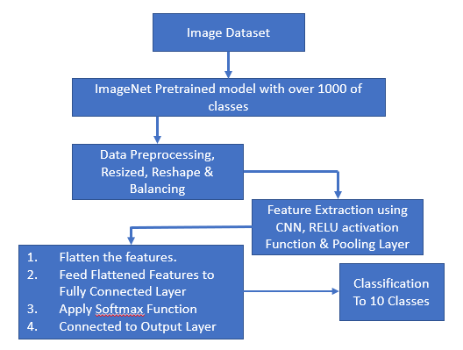
Experiments (Cont’d)
Transfer Learning
Transfer learning method focuses on utilize the knowledge which was previously gained while solving the different problems and applying it to a targeted tasks.
An Increased volume of experiments have investigated pre-trained models in the presence of finite learning samples.
Transfer learning led to faster convergence and outperformed training from scratch ad reduces the overall computational cost because of pre-trained ConvNets.

Slide 12
Results
FER2013 Dataset
Model | Accuracy | Loss | F1
Vanilla CNN | 0.62 | 2.88 | 0.62
ST-CNN | 0.73 | 1.18 | 0.73
VGG16 | 0.52 | 1.50 | 0.51
VGG19 | 0.49 | 1.56 | 0.48
ResNet50 | 0.44 | 1.53 | 0.38

Slide 13
Results (Cont’d)
CK+ Dataset
Model | Accuracy | Loss | F1
Vanilla CNN | 0.97 | 0.14 | 0.97
ST-CNN | 0.98 | 0.12 | 0.98
InceptionV3 | 0.95 | 0.26 | 0.94
VGG16 | 0.98 | 0.04 | 0.99
VGG19 | 0.97 | 0.05 | 0.98
ResNet50 | 0.89 | 0.40 | 0.85

Slide 14
Results (Cont’d)
Model | Accuracy | Loss | F1
ST-CNN (Age) | 0.59 | 1.17 | 0.56
VGG16 (Age) | 0.61 | 1.05 | 0.56
VGG19 (Age) | 0.66 | 1.07 | 0.55
InceptionV3 (Age) | 0.52 | 1.30 | 0.48
ResNet50 (Age) | 0.14 | 1.76 | 0.04
ST-CNN (Gender) | 0.91 | 0.53 | 0.90
VGG16 (Gender) | 0.91 | 0.33 | 0.91
VGG19 (Gender) | 0.89 | 0.51 | 0.89
InceptionV3 (Gender) | 0.81 | 0.38 | 0.81
ResNet50 (Gender) | 0.50 | 0.70 | 0.33
UTKFace Dataset

Slide 15
Conclusion
Insufficient and imbalance data
Hard to train an image-based model more effectively with less validation loss and sufficient accuracy.
Transfer learning methods, training image-based models with a particular size like (224*224)
More GPU power in order to train them fast and effectively.
Finally, based on the results we conclude that,
ST-CNN outperforms in FER database for emotion detection.
Transfer learning outperforms in UTK dataset for age & gender detection.
ST-CNN and Transfer Learning method performed equally on CK dataset for emotion detection
Vanilla CNN performed average in all the datasets.

Slide 16
Future Work
Use Vision Transformer such as Swin Transformers
Incorporate image segmentation techniques into image preprocessing
To use more efficient image dataset to improve the emotion detection accuracy
To work on more deep models to reduce the loss and improve the efficiency of the face features detection
Include various other factors like "race" detection .

Slide 17
References
Adjabi, I., Ouahabi, A., Benzaoui, A., & Taleb-Ahmed, A. (2020). Past, Present, and Future of Face Recognition: A Review. Electronics, 9(8), 1188. MDPI AG. Retrieved from http://dx.doi.org/10.3390/electronics9081188
Foggia, P., Greco, A., Saggese, A., &amp; Vento, M. (2023). Multi-task learning on the edge for effective gender, age, ethnicity and emotion recognition. Engineering Applications of Artificial Intelligence, 118, 105651. https://doi.org/10.1016/j.engappai.2022.105651
K. He, X. Zhang, S. Ren, and J. Sun. Deep residual learning for image recognition. In Proceedings of the IEEE conference on computer vision and pattern recognition, pages 770–778, 2016.
L. Carey, E. Winer, G. Viale, D. Cameron, and L. Gianni. Triple-negative breast cancer: disease entity or title of convenience? Nature reviews Clinical oncology, 7(12):683–692, 2010.
N. Tajbakhsh, J. Y. Shin, S. R. Gurudu, R. T. Hurst, C. B. Kendall, M. B. Gotway, and J. Liang. Convolutional neural networks for medical image analysis: Full training or fine tuning? IEEE transactions on medical imaging, 35(5):1299–1312, 2016.
P. Sermanet, D. Eigen, X. Zhang, M. Mathieu, R. Fergus, and Y. LeCun.Overfeat: Integrated recognition, localization and detection using convolutional networks. arXiv preprint arXiv:1312.6229, 2013.

Slide 18
Thank you!

